Slide 1
SPY bot

Slide 2
Features
Wireless Control over WIFI
Dedicated android application
Live Video Broadcasting
Control using accelerometer

Slide 3
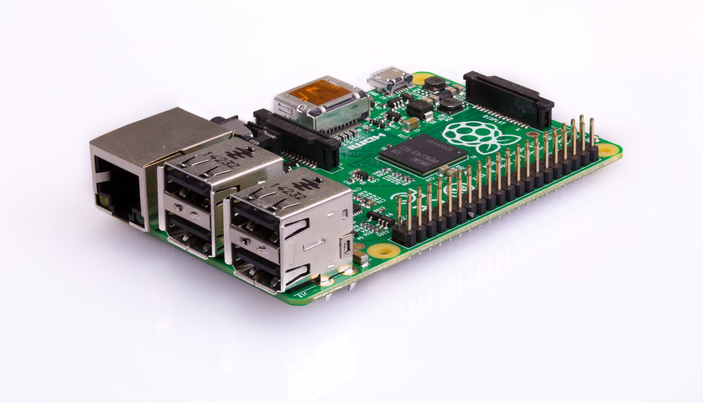
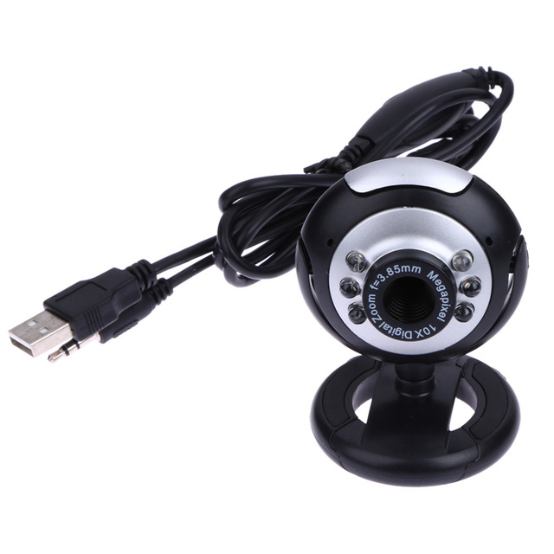
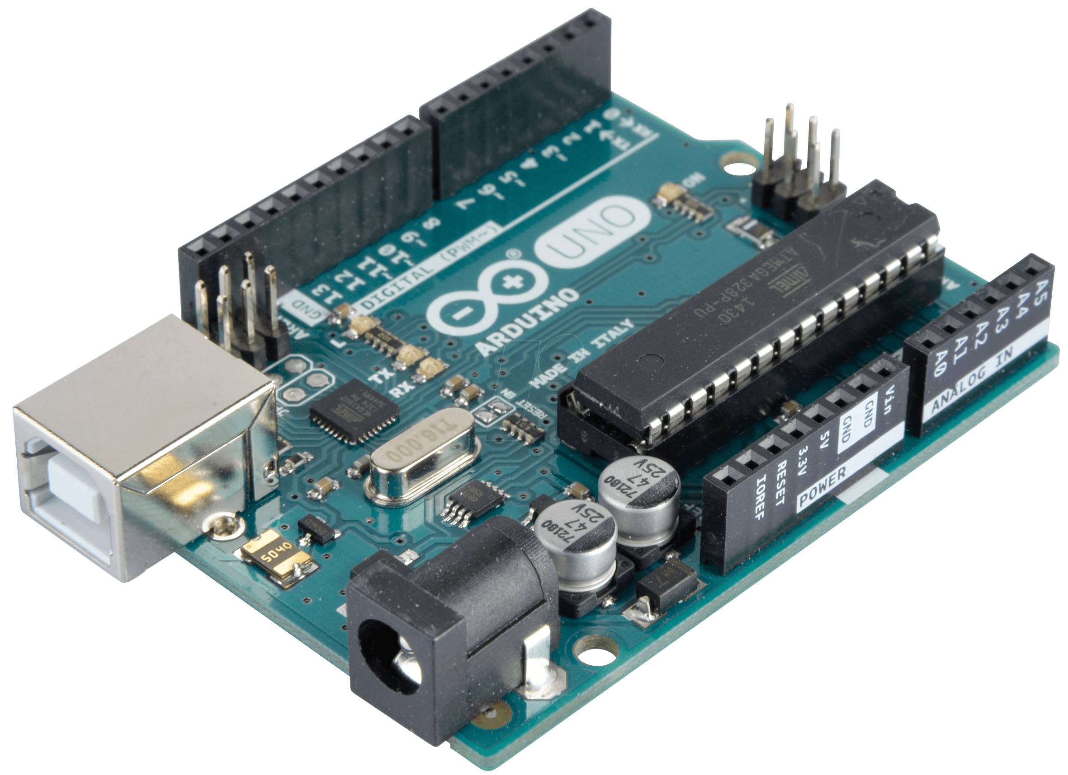
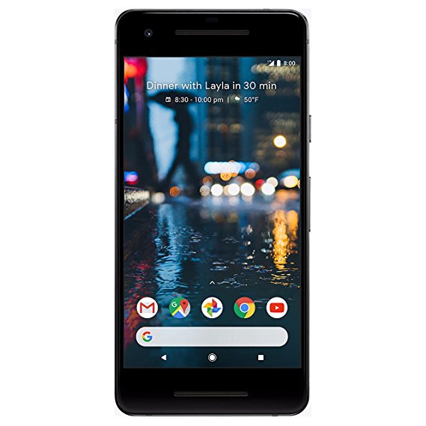
Components Used
Raspberry Pi (model 2B)
Arduino
Android Phone
Camera
DC Motors
Batteries
Wheels
Chassis

Slide 4
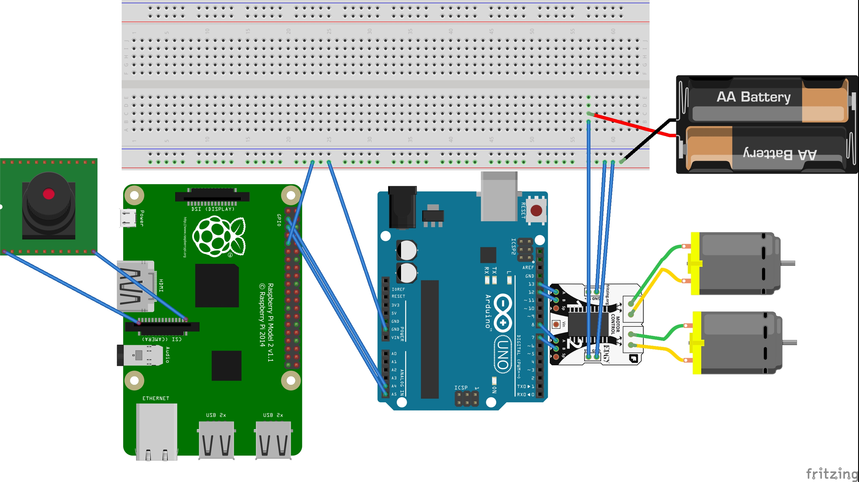

Circuit Diagram

Slide 5
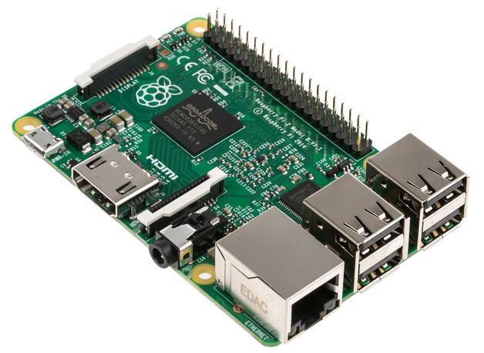
Phone to Raspberry Pi Communication
Runs Robotics.apk application
Makes http request to pi IP address
Receives and display live video feed
Flask Server to handle http request
Web.py broadcast video and receives control commands
Saves command into SQLite database

Slide 6
Raspberry Pi to Arduino Communication
Arduino is a slave device
Receives commands from Raspberry Pi using I2C protocol
Sends command signals to the motors
I2c
Raspberry Pi is a master device
Reads commands from SQLite database
Sends command signals to Arduino using I2C Protocol

Slide 7
For Source Code and Android application
Visit: https://github.com/pranjulsingh/Wireless-Car-with-Camera

Slide 8
Thank You

